Slide 1
Live Weather Monitoring System using Iot
Guided by- Dr. P. N. Kalavadekar

Slide 2
Introduction
A weather Monitoring System is a device that collects data related to the weather and environment using many different sensors.
Weather Monitoring System is also a facility that can use for measuring atmospheric conditions to provide information for weather forecasts and to study the weather and climate.
Therefore, Weather Monitoring System using Internet of Thing is proposed to help user access data about weather anywhere in real-time.

Slide 3
Table of contents
1
4
2
5
3
6
Problem Statement
Requirements
(Page no – 4)
(Page no – 7)
Objective
Circuit Diagram
(Page no – 5)
(Page no – 10)
Scope
Conclusion
(Page no – 6)
(Page no – 11)

Slide 4
Problem Statement
Limited way for user to know about weather such as temperature, humidity and pressure.
Without Weather Monitoring System User can't be alerted of the strong winds, heat waves or any other weather related emergency..

Slide 5
Objective
2
3
1
To design a facility that can help user to access data anywhere in real time.
To develop weather station that can help user to plan their day to day activities.
To test the capabilities and effectiveness of the Weather Station and generate the data to the user.

Slide 6
Scope
The scope is important to set a boundary on what the area will cover in the project. Thus Weather Station using Internet of Things is focused on getting data about weather like temperature, humidity, and pressure.
User –
Can view the data of temperature, humidity and wind speed.
ii. System-
Collects whether data from whether station.
Save the real time data and sent the data to local server

Slide 7
Requirements
This project is all about IoT based Live Weather Monitoring Using NodemCU ESP8266. We will interface DHT11 Humidity & Temperature Sensor, BMP180 Barometric Pressure Sensor, and FC37 Rain Sensor with NodeMCU ESP8266-12E Wifi Module. We will measure humidity, temperature, Barometric pressure, and rainfall.

Slide 8
Components Required
The components needed for this project, i.e., IOT Live Weather Monitoring Using NodemCU ESP8266 are given below
S N | COMPONENTS NAME | DESCRIPTION
1 | Node MCU | ESP8266-12E Board
2 | BMP180 Sensor | BMP180 Barometric Pressure Sensor from Bosch
3 | DHT11 Sensor | DHT11 Humidity Temperature Sensor
4 | Rain Sensor | FC-37 Rain Sensor Module
5 | Resistor | 4.7 K
6 | Connecting Wires | Jumper Wires
7 | Breadboard | -

Slide 9
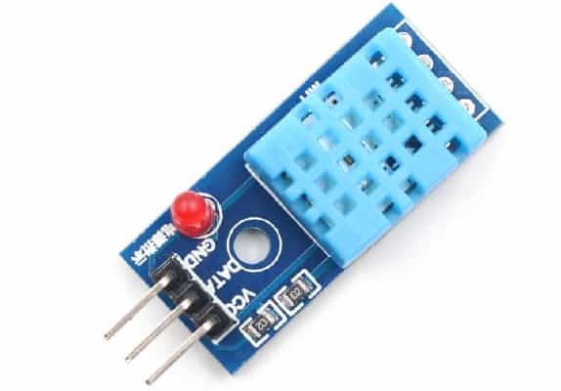
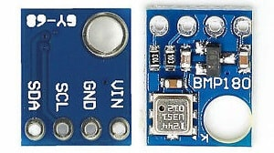
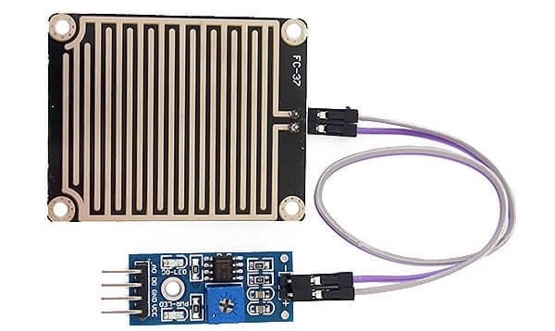
Sensors Used:
1. DHT11 Humidity & Temperature Sensor:
The DHT11 is a basic, ultra low-cost digital temperature and humidity sensor. It uses a capacitive humidity sensor and a thermistor to measure the surrounding air and spits out a digital signal on the data pin.
2. BMP180 Barometric Pressure Sensor:
The BMP180 is the new digital barometric pressure sensor of Bosch Sensortec, with a very high performance, which enables applications in advanced devices such as smartphones, tablet PCs, and sports devices.
3. Rain Sensor:
Rain sensors are used in the detection of water beyond what a humidity sensor can detect.

Slide 10
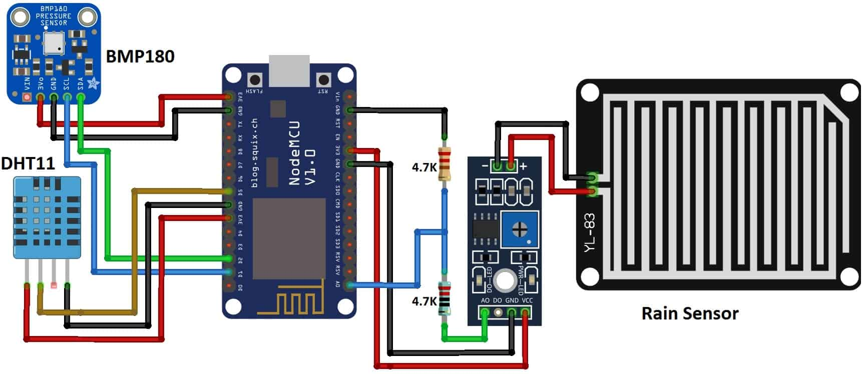
Circuit Diagram & Connections
Below is the circuit diagram for making Live weather Sation Monitoring Using NodeMCU. The circuit is as shown in the figure below.

Slide 11
CONCLUSION
Weather Monitoring Using Internet of Things (IoT) is a project which focus on user can access weather report anywhere in real-time. Based on the previous systems, the suitable approach is implemented in this system which is Internet of Things (IoT). This project provide accurate weather forecasts by using Iot. Once a weather monitoring system is connected, user can view the weather and environment as well. User can figure out the trends in the measurements. Hopefully this project can help to overcome the problem in order to make a new production more efficiently

Slide 12
Thank You !
Presented By- 35. Dhamane Paresh
36. Dhole Aditya
40. Gangurde Aniket
54. Sayyad Jishan

